Slide 1



Slide 2
Fuzzy C-Means
An extension of k-means
Hierarchical, k-means generates partitions
each data point can only be assigned in one cluster
Fuzzy c-means allows data points to be assigned into more than one cluster
each data point has a degree of membership (or probability) of belonging to each cluster

Slide 3
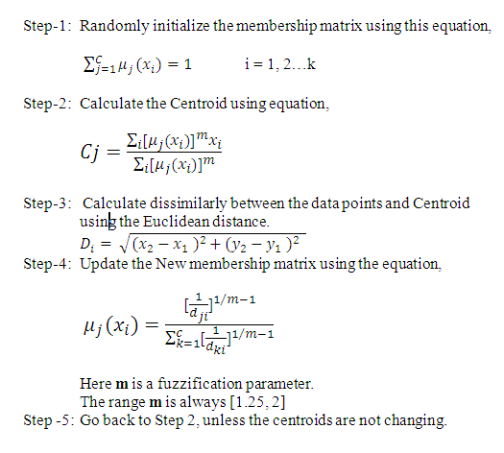
Fuzzy C Means Algorithm

Slide 4
Worked out Example
Input: Number of Objects = 6
Number of clusters = 2
X | Y | C1 | C2
1 | 6 | 0.8 | 0.2
2 | 5 | 0.9 | 0.1
3 | 8 | 0.7 | 0.3
4 | 4 | 0.3 | 0.7
5 | 7 | 0.5 | 0.5
6 | 9 | 0.2 | 0.8

Slide 5
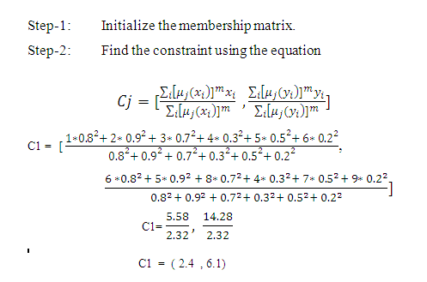

Slide 6
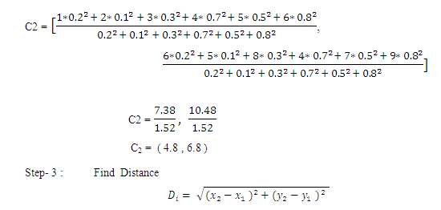

Slide 7
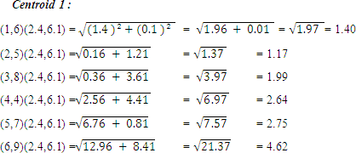

Slide 8
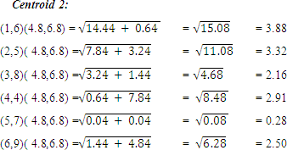

Slide 9
Cluster 1 |  | Cluster 2
Datapoint | Distance | Datapoint | Distance
(1,6) | 1.40 | (1,6) | 3.88
(2,5) | 1.17 | (2,5) | 3.32
(3,8) | 1.99 | (3,8) | 2.16
(4,4) | 2.64 | (4,4) | 2.91
(5,7) | 2.75 | (5,7) | 0.28
(6,9) | 4.62 | (6,9) | 2.50

Slide 10
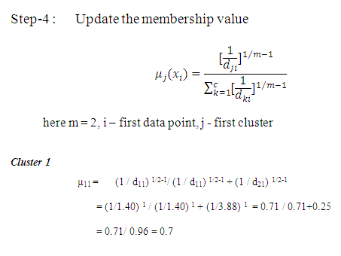

Slide 11
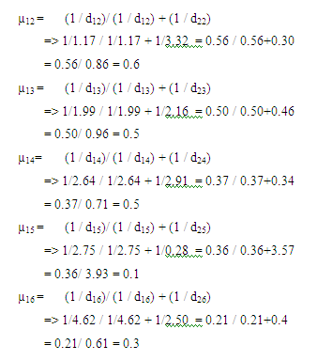

Slide 12
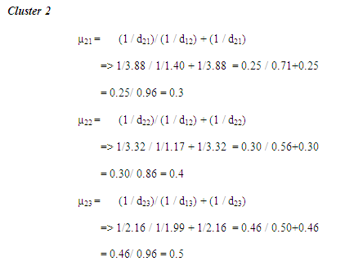

Slide 13
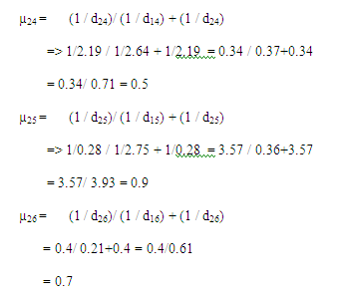

Slide 14
Now the New Membership value is
X | Y | C1 | C2
1 | 6 | 0.7 | 0.3
2 | 5 | 0.6 | 0.4
3 | 8 | 0.5 | 0.5
4 | 4 | 0.5 | 0.5
5 | 7 | 0.1 | 0.9
6 | 9 | 0.3 | 0.7
Step 5 : Now continue this process until get the same centroids.

